Slide 1
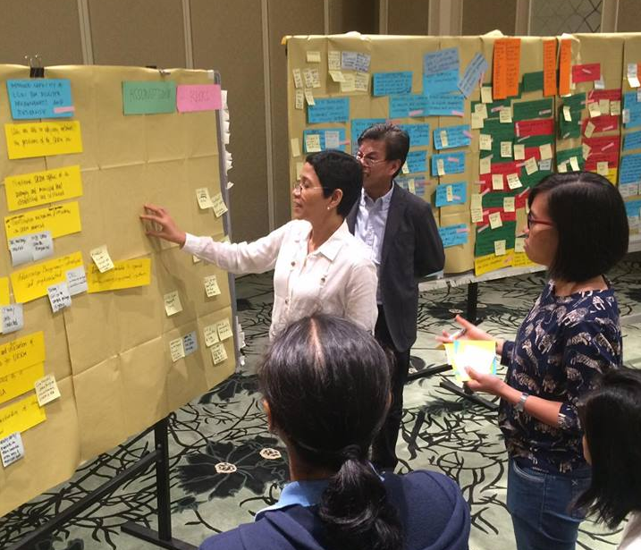
Evaluation in UNDP: Policy and practice
Marian Theresia Valera
UNDP in the Philippines
6th Monitoring & Evaluation Network Philippines Forum
6 December 2016

Slide 2
Presentation outline
1 UNDP Evaluation Policy: A Brief Overview
2 Managing Evaluations
3 Disseminating and Utilizing Evaluations

Slide 3
UNDP Evaluation Policy (2011): How is Evaluation defined?
Evaluation Criteria
Objective and Independent
Accountability
Lessons learned
Relevance
Effectiveness
Efficiency
Impact
Sustainability
Assessment of what works and why
Highlights intended and unintended results
Strategic lessons to guide decision-makers and inform stakeholders
Rigorous
Systematic
Objective Process
Notes:
Evaluation is a judgement made of the relevance, effectiveness, efficiency, impact and sustainability of development efforts, based on agreed criteria and benchmarks among key partners and stakeholders. It involves a rigorous, systematic and objective process in the design, analysis and interpretations of information to answer specific questions. It provides assessments of what works and why, highlights intended and untended results, and provides strategic lessons to guide decision-makers and inform stakeholders.

Slide 4
Key Evaluation Questions
Accountability
Are we doing the right thing?
Lessons Learned
Are we doing it right?
Are there better ways of doing it for better results?
Did we achieve what we set out to achieve?
What can we learn from our work?
Did it work or not, and why?

Slide 5
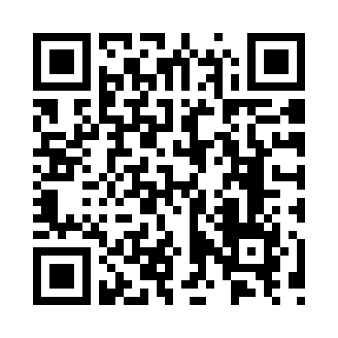
Handbook on Planning, Monitoring and Evaluating
for Development Results (2009)
Can be downloaded from:
http://web.undp.org/evaluation/guidance.shtml#handbook

Slide 6
Category of evaluations
Independent evaluations – conducted by the Independent Evaluation Office in New York (Assessment of Development Results (ADR))
Decentralized evaluations – commissioned by programme units (e.g. Country Offices) and conducted by independent external experts. UNDP conducted 253 decentralized evaluations in 2015:
159
37
16
15
$7.5 M
project evaluations
outcome evaluations
UNDAF evaluations
Country
Program &
other
evaluations
Notes:
IEO
Thematic evaluations
Regional and global programme evaluations
South-South programme evaluations
Assessment of Development Results (ADRs)
Decentralized
Mandatory when included in the evaluation plan annexed to the global, regional, country programme documents and/or the Project Documents
Mandatory when required by a cost-sharing agreement or partnership protocol (e.g. Global Environment Facility)
Types (mid-term or terminal)
UNDAF evaluations – focusing on UNDAF outcomes, their contributions to national priorities
Country programme evaluations – assessment against planned results
Outcome evaluations
Thematic evaluations
Project evaluations

Slide 7
UNDP Practice: Managing Evaluations
Plan
Evaluability
TOR
Inception
Data collection
Draft report
Final report
Management response
Use
Recruitment
Roles

Slide 8
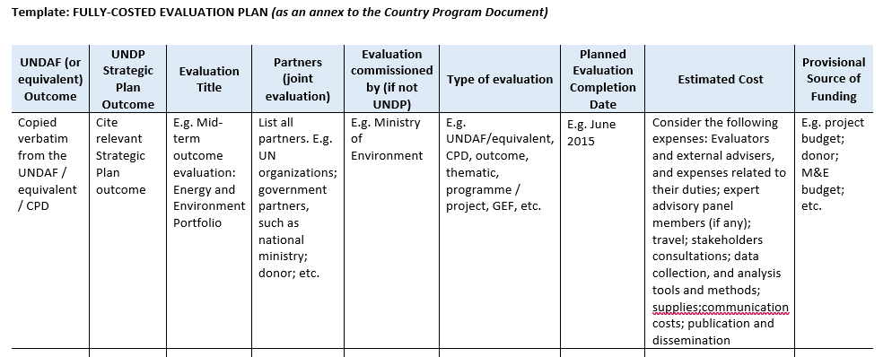
UNDP’s policies on evaluation management
A costed Evaluation Plan is required as part of program and project documents
Notes:
An evaluation plan formulated for the entire programming period, normally at the start of the programme – including types of evaluation, timeline, and amount and sources of allocated budget (share the template of an EP)
Each evaluation in the plan should have a clear purpose as it will determine the type of evaluation, timeline, scope, budget, etc.

Slide 9
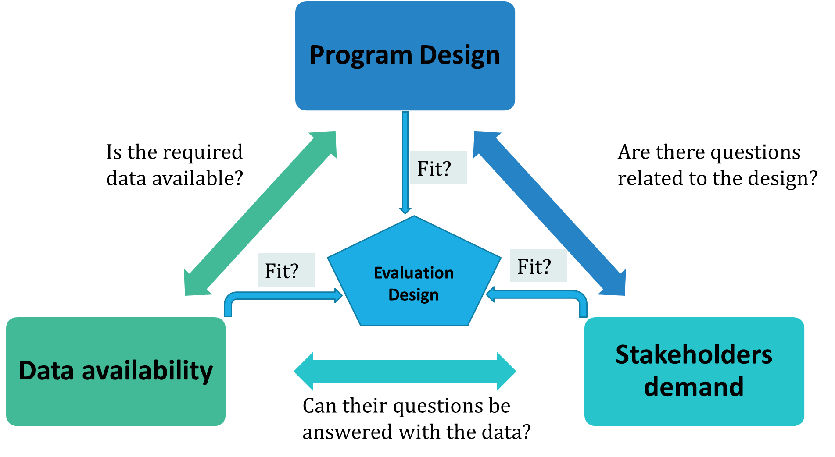
What to examine during evaluability assessment?
Notes:
Adequacy of programme design - its clarity, coherence, and relevance.
Quality of the program documents – Plausibility of TOC,
Quality of the outcome statement, results framework, articulation between levels of results,
Availability of quality information - including both content and quality of data
Quality of monitoring systems, indicators, baseline information, system to collect data,
Completeness of data for the indicators; gaps;
Conduciveness of the context - including stakeholders’ views and resources available.
Level of stakeholders’ involvement
Existence of resources and capacities to undertake evaluation
Institutional and sociopolitical context that could influence the independence of evaluation
Generally deploys qualitative data collection methods: desk reviews, secondary data analysis, interviews, focus groups with key stakeholders.
Depending on the time available and the magnitude of evaluation, it can take days, weeks or months. If only desk-based with some stakeholder consultation, it can be done within 5-7 days.
Checklist is a common approach (share the checklist)

Slide 10
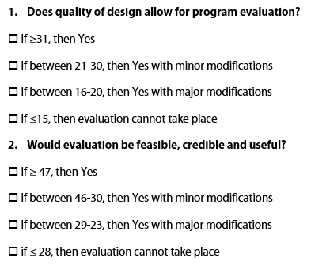
Evaluability Assessment

Slide 11
Evaluation Governance: Roles and Responsibilities
Commissioners of the Evaluation
Senior management (CD, UNDP) and National Government Coordinating Entity
Some of the members of the Outcome Board, UNDP CD
National counterparts
Stakeholders (Donors, beneficiaries)
Chair, UNDP Programme Officers, representative from MSU (CO)
Evaluation Manager
Evaluation team (external)
National Counterparts' technical level representative
Evaluation Steering Committee (ESC)
Evaluation Management Group (EMG)
(additional) Quality assurance panel members
Notes:
Commissioner of the evaluation: Resident Representative/Country Director of UNDP in consultation with relevant counterparts
Reference group Or Steering Committee
Quality assurance or evaluation management group
Evaluation manager
Evaluation team
Setting up the evaluation governance mechanism and inform all the stakeholders and members involved in this mechanism

Slide 12
Evaluation Management: UNDP Templates and Checklists
Evaluation Plan Template
Evaluability Assessment Checklist
Evaluation Governance TOR: Roles and responsibilities
Evaluation Manager’s Checklist
Quality checklist for Evaluation TOR and Inception Reports
Quality Checklist for Evaluation Reports
Evaluation Matrix Template
Management Responses Template

Slide 13
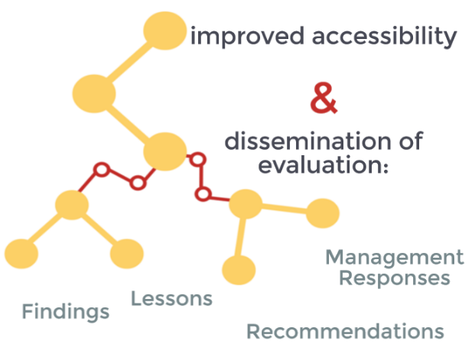
Dissemination of Evaluation

Slide 14
Dissemination of Evaluation
Dissemination workshops with stakeholders
Upload in program unit websites and social media or portions of it
Translation into local languages to increase access
Publish summaries
Issue short papers, extract lessons
Share lessons with stakeholders
Use lessons to influence or inform policy makers
Upload in the Evaluation Resource Center (ERC), which is a public site

Slide 15
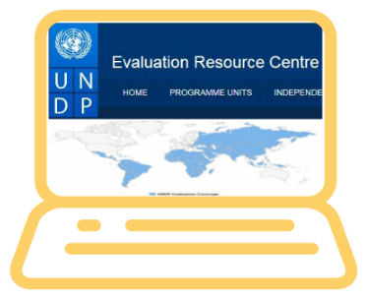
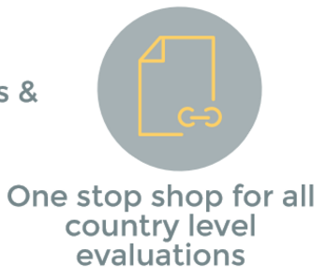
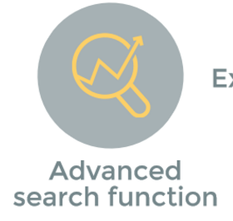
ERC.UNDP.ORG
Publicly accessible online repository and databank of all UNDP evaluations
Notes:
The Evaluation Plan has to be uploaded on the online platform called the Evaluation Resource Center (ERC) which is publicly accessible
Once an evaluation is commissioned, all key documents must be uploaded on the online platform such as TOR, Reports, Management response.
Management response has to be provided to all evaluation recommendation with action points and uploaded in ERC
The Program Unit is responsible for implementing the action plan and updating the status of each action online. HQ follows up annually on the status of the action plan and sends alerts when an action remains unimplemented.
ERC is an integral part of UNDP’s knowledge management system
Source of learning
Promotes evidence-based decision-making

Slide 16
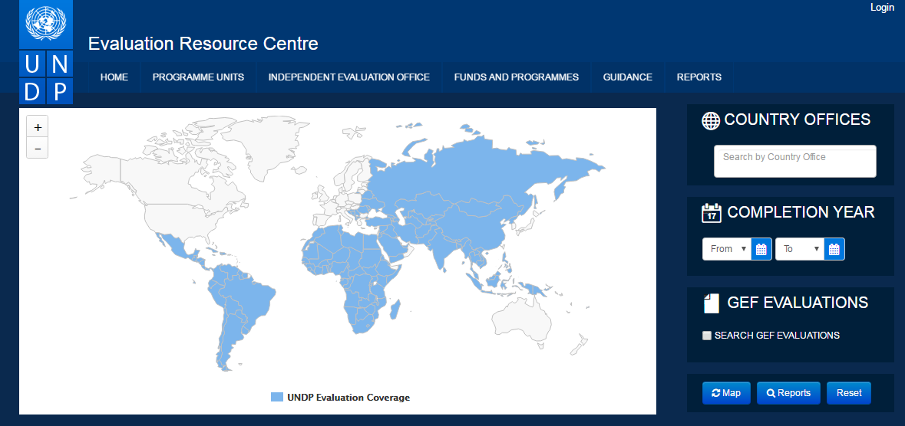

Slide 17
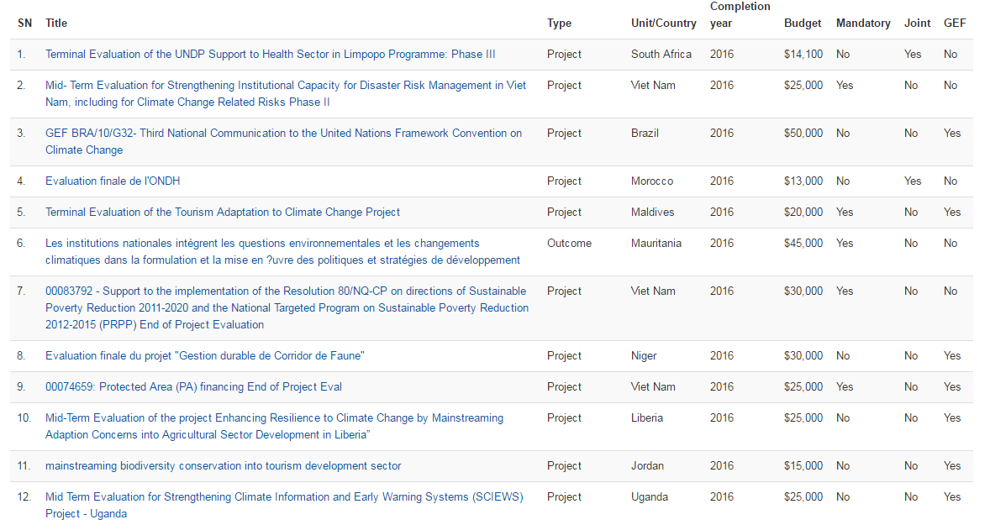

Slide 18
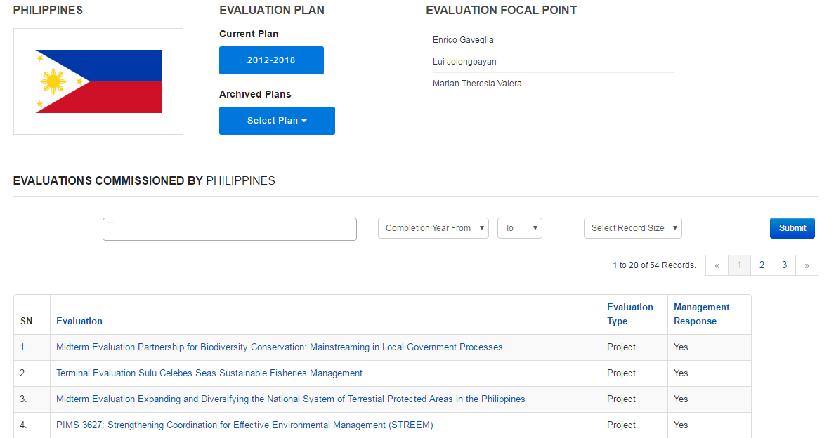

Slide 19
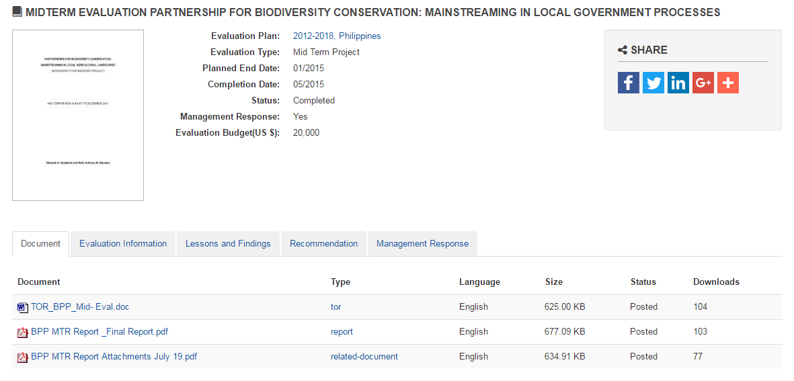

Slide 20
Reference to Evaluation Findings
UNDP Project Quality Assurance

Slide 21
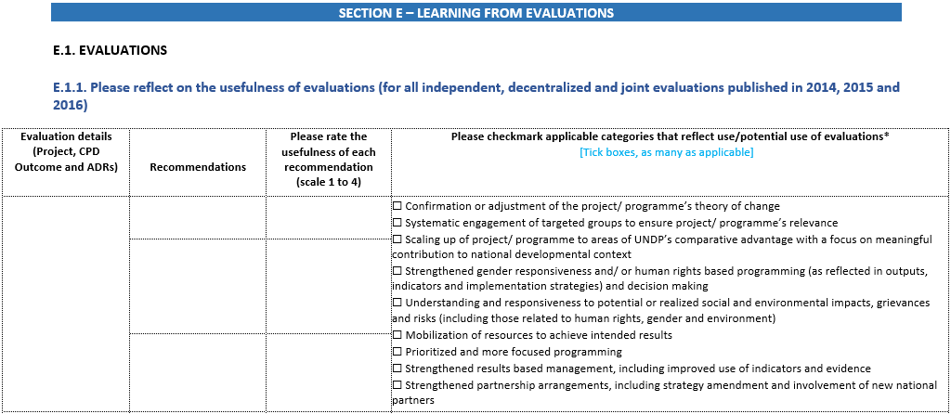
Reference to Evaluation Findings
UNDP Results Oriented Annual Report

Slide 22
Use of Evaluation Findings
Inform improvement in implementation and arrangements
Inform programme planning and design
Influence policy makers to design new / improve existing policies
Provide key internal lessons for program implementers
Demonstrate transparency and accountability
Provide insights into good practices and lessons learned
Notes:
To inform improvement in implementation and arrangements of ongoing programmes
To inform future programme planning and design
To inform and influence policy makers to design new or improve existing policies
To provide key internal lessons for those implementing programmes
To demonstrate transparency and accountability
To provide insights into good practices and lessons learned

